Slide 1

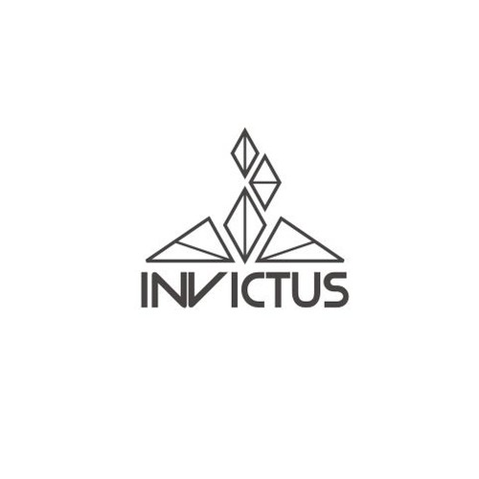
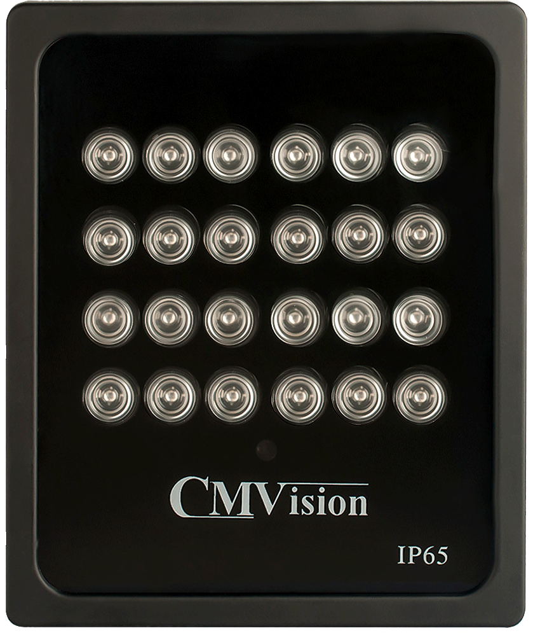
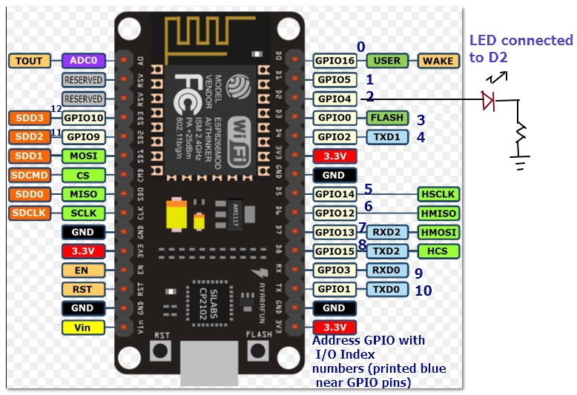
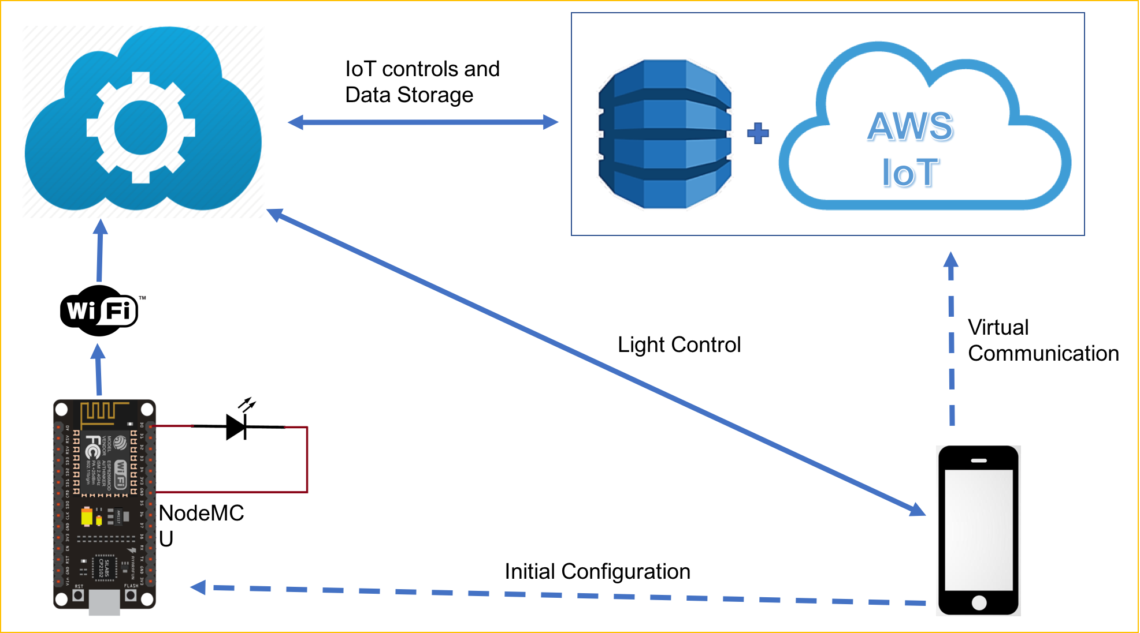
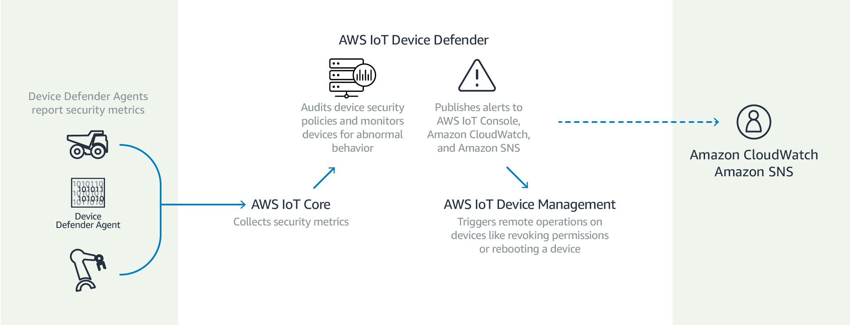
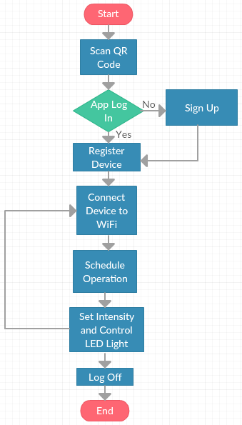
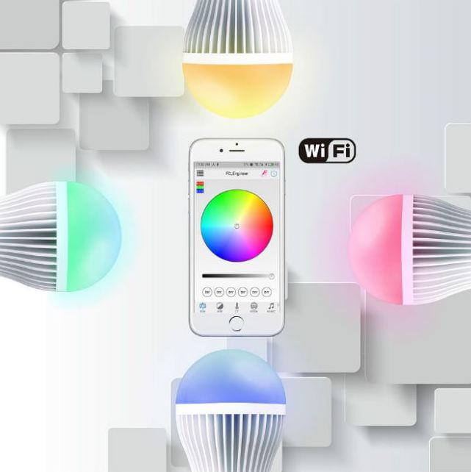
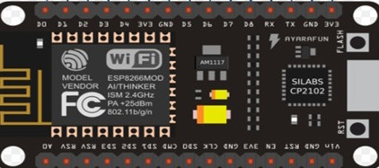



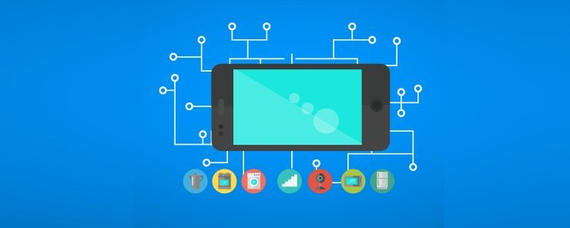
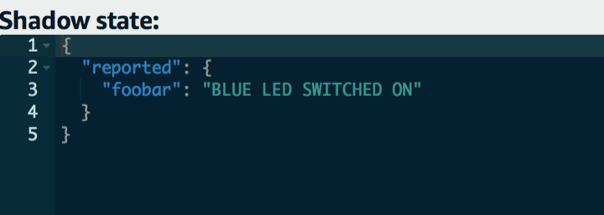
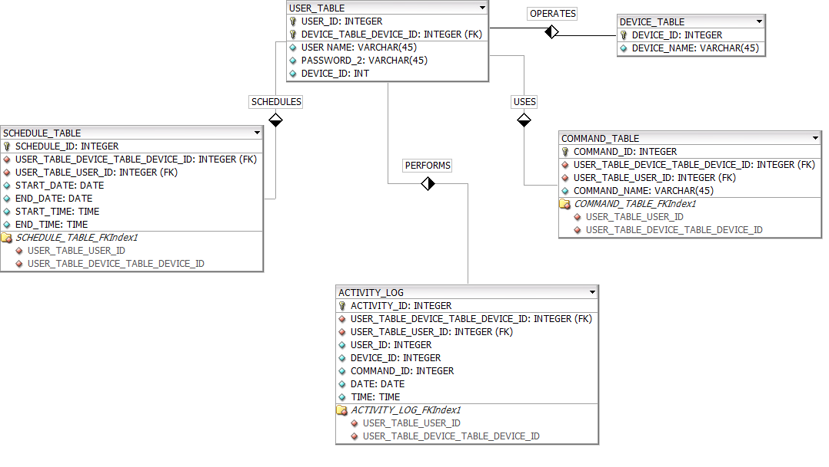
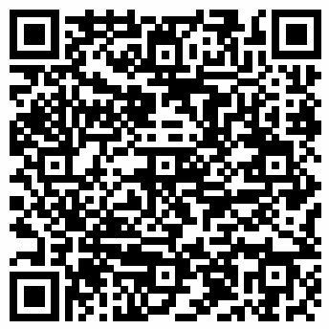
Mobile Cloud Supported Smart Light IoT System
Sai Lochan Reddy Reddipalli, Sasidhar Pasupuleti, Raghuram Kambhampati, Rohith Raj Reddy Alla Sai Poorna
Advisor: Kewei Sha
College of Science and Engineering, University of Houston – Clear Lake
Mentor: Yimming Yang – CM Vision Tech
Introduction
Methodology
Future Work
Our Project develops a Mobile Application which enables cloud connection and control for a traditional Led Light. With this app the users can remotely configure the light by changing the schedule of operations, RGB patterns and the intensity. This is achieved through a user-friendly Mobile and Web Interface which also allows new user and device registration through a QR code for a secure connection.
Hardware
Architecture
Extended Cloud Support
Smart lights are targets for hackers because owners often use default passwords that come with their networks. We can use AWS IoT Device Defender to audit connection attempts to the device connected and if that data comes from an unauthorized endpoint, you will receive an alert.
Objectives
Develop a Mobile Application with a seamless User Interface on the iOS Platform.
Use Wi-Fi as the communication protocol between the devices.
Connect the Light with NodeMCU.
Provide a secure connection by registering users and adding devices through QR code.
Enable remote access for controlling the light through the internet.
Create a database to collect session data and enable cloud connection.
Read light status, change RGB pattern, change intensity and set schedule for the light through a mobile and web interface.
Proposed System
The system consists of CMVision Light, NodeMCU , AWS and Mobile application.
The light is connected to NodeMCU and controlled by it.
The mobile application will initially connect with NodeMCU configured as a hotspot.
The user configures NodeMCU to connect with home Wi-Fi using the mobile application.
The application holds a variety of options and settings to control the light. The user can select an option and can interact with the light through a mobile or web interface.
The commands from the mobile and web interfaces go through the AWS cloud database to reach the light.
Added Functionality
Music Controlled LEDs
For example, by adjusting its sensitivity we can make it less sensitive to reacts only on high note beats or we can also make it more sensitive to react on every little beat in the music.
Temperature Controlled LEDs
For example, if the reference voltage is 0.8V, then the voltage at the non inverting input becomes 0.8V when the temperature is 80 degree Celsius.
Motivation
Results
Conclusions
Mobile Application
TEST | Memory Usage | Delay | Storage | Security | Stability
Mobile Application | 7 MB | < 3 Sec | 3 MB | QR Code | Good
NodeMCU | Nearly 4 KB | ~ 5 ms | 45 KB | Password | Excellent
AWS | < 1 GB | ~ 10 ms | 25 GB (Cloud) | Permission File | Excellent
Database | ……… | ~ 7 ms | ……… | User Authentication | Good
We successfully deployed the app with the required functionality using Xcode, Arduino Workbench, MySQL DB and AWS Instance.
AWS as a cloud service offers immense functionality though it is complex to setup when compared to a traditional network. Support for NodeMCU is limited.
AWS could be further explored for device management and cloud security to work with a network of connected devices.
NodeMCU is the most economical way to implement AWS IoT applications. It offers both basic and advanced programmable hardware functionality. Support for multiple platforms makes it flexible as well.
MQTT is the primary protocol in play for communicating with AWS IoT server.
MySQL DB is compatible with JSON format for commands. It works best with a server based application.
“Executives rank the Internet of Things as their top technology priority, it’s becoming a competitive differentiator that will affect almost every industry.”
Bruce Rogers, Chief Insights Officer at Forbes Media.
More at:
Market for Internet of things (IoT) is projected to hit $267 billion by 2020. Many traditional companies are trying to parlay IoT into connected services which can create tangible value and profit.
AWS Shadow
Database Schema
References
Ever since mobile became more than a way of communication, mobile apps have added more value to users than any of us ever expected.
IoT is one such technology that has immense potential to create constant value and absolute control for the users.
IoT Mobile Applications create a refreshingly satisfying experience and through IoT enabled products. This brings in a huge customer database.
Scalability, Data Management, Device Management and Security are some of the primary advantages of cloud based applications.
Bertino, E., Choo, K. R., Georgakopolous, D., & Nepal, S. (2016). Internet of Things (IoT). ACM Transactions on Internet Technology, 16(4), 1-7. doi:10.1145/3013520
P., S., S., S., M., A., & Ushaa, E. (2016). Realizing Internet of Things Using Arduino, ESP8266 and IIS Server and MySQL DB For Real-Time Monitoring and Controlling Multiple Fire Alarm Systems Over a Wireless TCP/IP Network. I-manager’s Journal on Software Engineering, 11(2), 13. doi:10.26634/jse.11.2.13444
P, P. (n.d.). Beginners guide to ESP8266, from https://tttapa.github.io/ESP8266/Chap04 - Microcontroller.html
Understanding the 802.11 Wireless LAN MAC frame format. (2017, April 26), from https://witestlab.poly.edu/blog/802-11-wireless-lan-2/
Kodali, R. K., & Soratkal, S. (2016). MQTT based home automation system using ESP8266. 2016 IEEE Region 10 Humanitarian Technology Conference (R10-HTC). doi:10.1109/r10-htc.2016.7906845
Device Registration

